Slide 1
POS System
Made By: Ayham Alkhalaileh

Slide 2
Introduction
Point of sale (POS) refers to the location where a retail transaction is completed. It is usually a physical location such as a store, restaurant, or other retail establishment, but can also refer to an online or mobile platform where transactions are processed. A point-of-sale system is the hardware and software used to process a transaction. It also includes related software, such as inventory management and customer relationship management software.

Slide 3
Problem Statement
The aim of the project is to solve the problem we are facing so that traditional stores need a software that stores transactions and inventory in an electronic way instead of the traditional way that is time consuming and takes more effort.

Slide 4
Objectives
Selling, Buying, Renting and Repairing.
Inventory Management.
Customer Orders and Suppliers Orders Management.
Integrated Supplier Purchasing.
Consistent and Customizable Reports.
Multi-Store Management.

Slide 5
System Analysis
admin
seller
procurement
accountant
controls all parts of the system
controls the selling panel only
only controls the inventory management page
Controls the transaction management page only

Slide 6
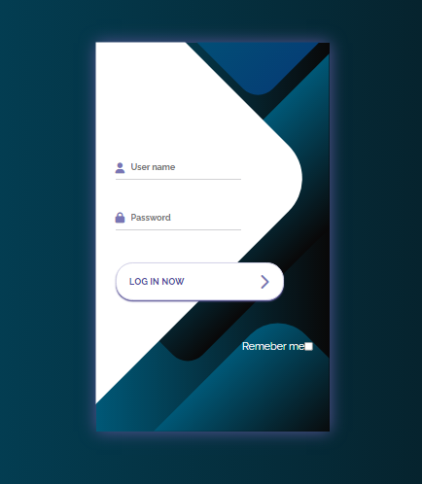
Implementation

Slide 7
Conclusion
Finally, the POS system will improve store efficiency, accuracy, and overall customer experience, leading to increased profits. The project is to create a web application that meets these requirements. The point of sale system will enable him to manage his shop with high efficiency and save time and effort if the project goals are achieved.

